Slide 1
Glaucoma
Keep Vision in Your Future

Slide 2
What to expect from this presentation

Slide 3
Objectives
You will learn:
What glaucoma is
How glaucoma affects vision
How eye doctors test for glaucoma
Why early treatment can help people make the most of their vision

Slide 4

Ground Rules
What ground rules do you think we need to create a positive learning environment?

Slide 5





Ground Rules (continued)
Keep your phones on silent and try not to look at them during the session
Speak up — and make room for others to speak
Give each other grace
Leave what’s said in the room, in the room
If joining virtually, turn your video on if you can
Can we all agree to the ground rules we discussed?

Slide 6
Let’s learn about glaucoma!

Slide 7
What is glaucoma?
Glaucoma is a group of eye diseases that can damage the optic nerve
There are different types of glaucoma
The most common type is called primary open-angle glaucoma

Slide 8
What are the symptoms of glaucoma?
At first, glaucoma has no symptoms. As it progresses, it can affect 1 or both eyes, and you may:
Lose your side vision
Have permanent vision loss or blindness

Slide 9
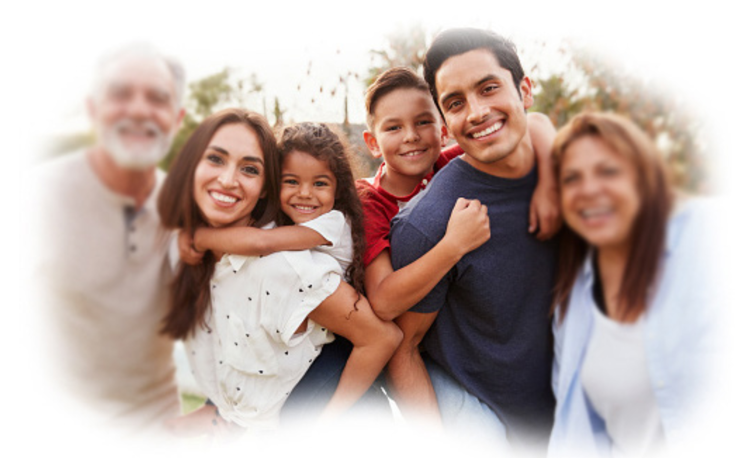
How does my vision change with advanced glaucoma?
The See What I See virtual reality app lets you use a filter to see how glaucoma affects your vision: nei.nih.gov/VR

Slide 10
How common is glaucoma?
Any guesses?

Slide 11

How common is glaucoma? (continued)
About 3 million people in the United States have glaucoma — that’s more than the population of Chicago! And half of them don’t know it.

Slide 12

Who can get glaucoma?
Anyone can get glaucoma, but some people can be at higher risk for it.

Slide 13

Who can get glaucoma? (continued)
Black/African American people age 40 and older
Adults age 60 and older, especially Hispanic/Latino people
People with a family history of glaucoma

Slide 14



What else makes me more likely to get glaucoma?
Diabetes
High blood pressure
Previous eye injury

Slide 15
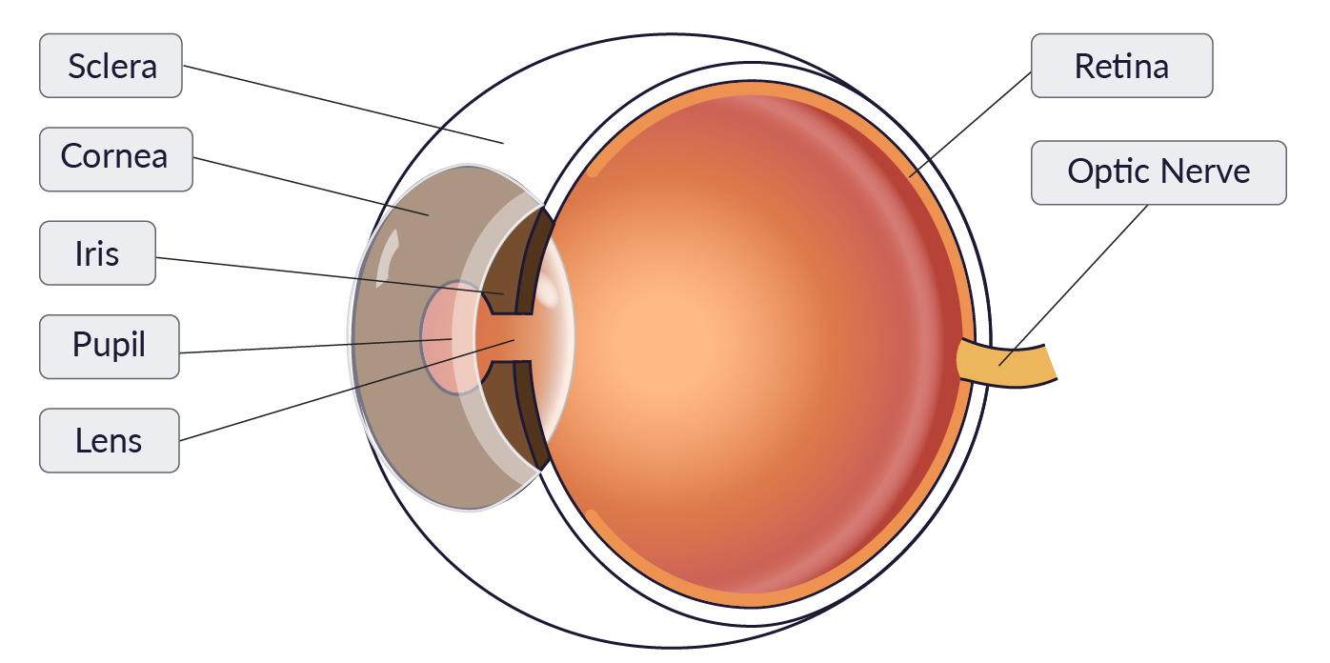
Parts of the Eye

Slide 16
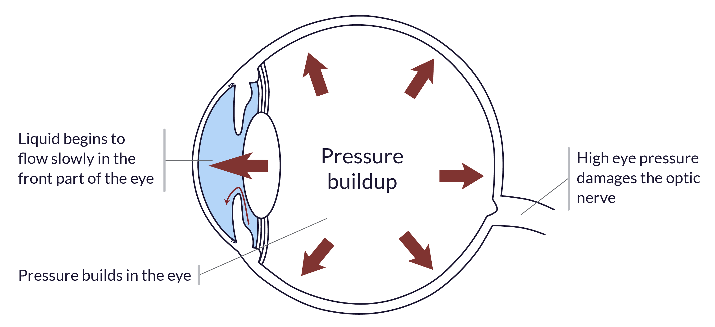
What causes glaucoma?

Slide 17
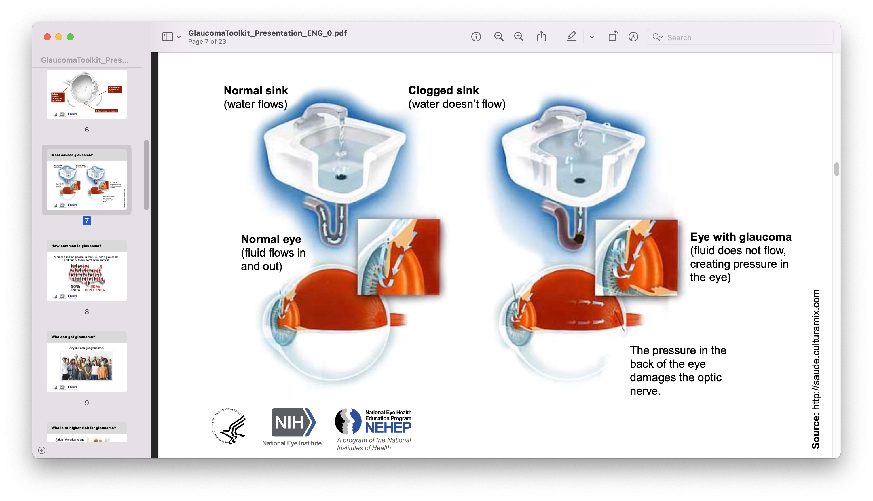
What causes glaucoma? (continued)
Check out an animation of how glaucoma raises eye pressure and damages the optic nerve: https://youtu.be/XlI_JXYMzbs

Slide 18
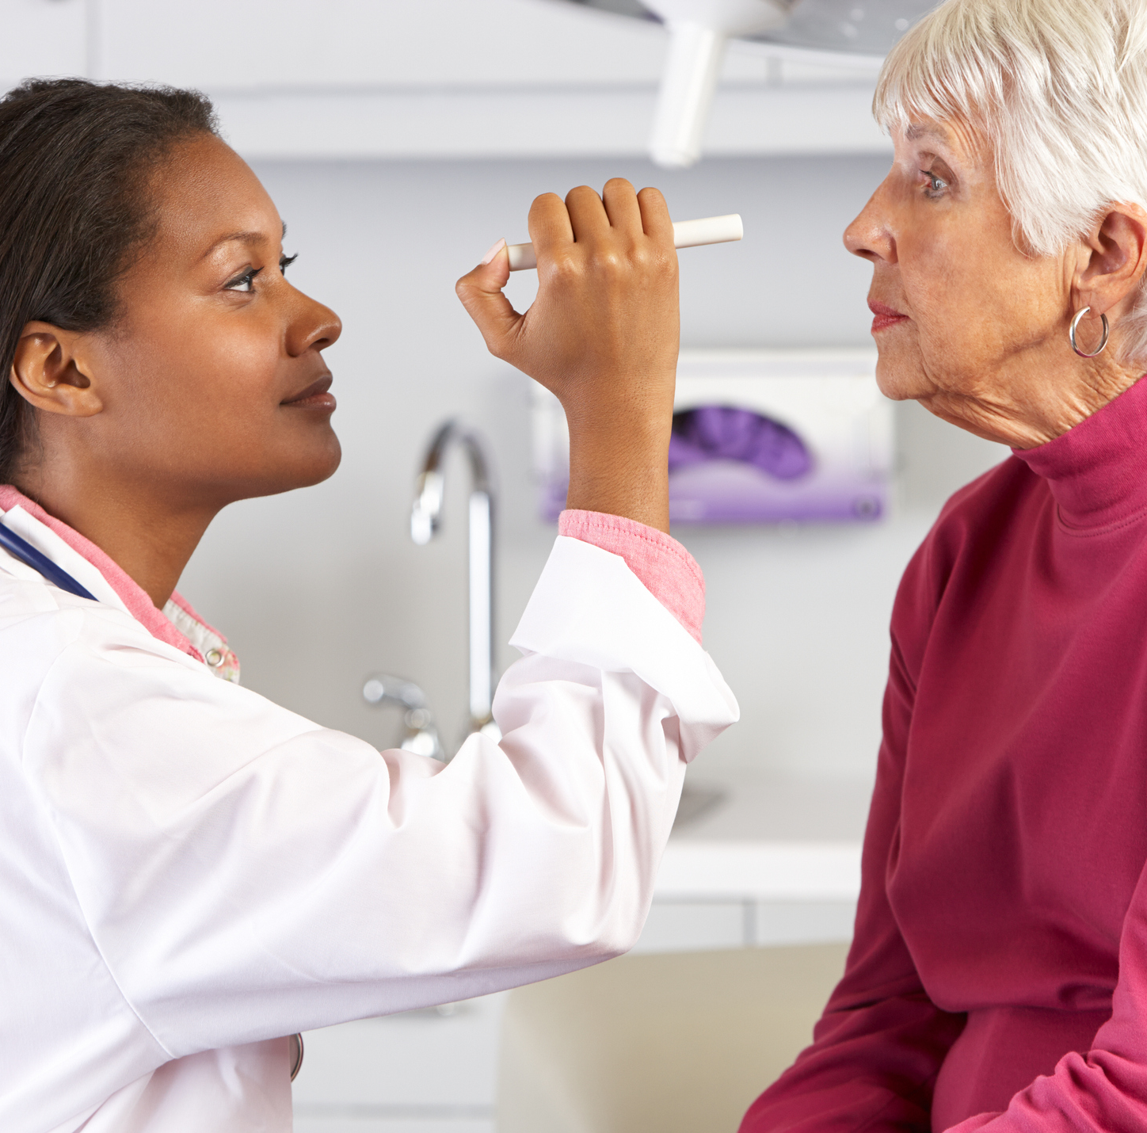
How do eye doctors test for glaucoma?
Your eye doctor can test for glaucoma with a comprehensive dilated eye exam since screening for eye pressure alone isn't enough.

Slide 19
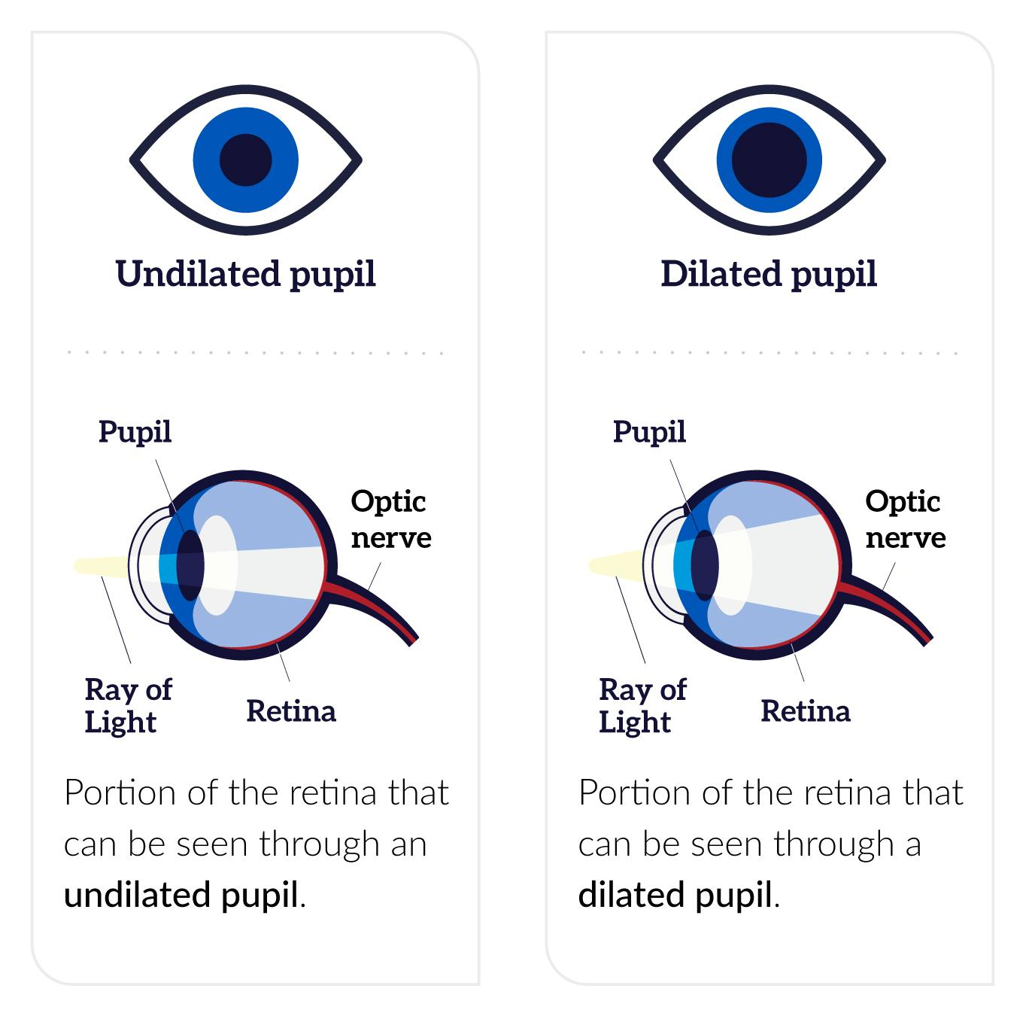
What is a dilated eye exam?
The exam is simple and painless
Your eye doctor will give you some eye drops to dilate (widen) your pupil and then check your eyes for glaucoma and other eye problems
The exam includes a visual field test to check your side vision

Slide 20
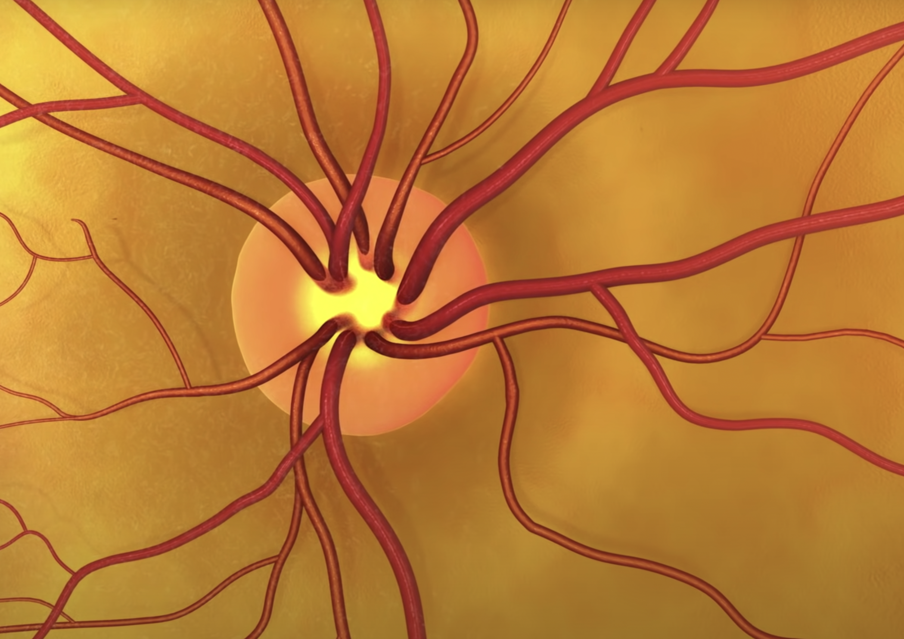
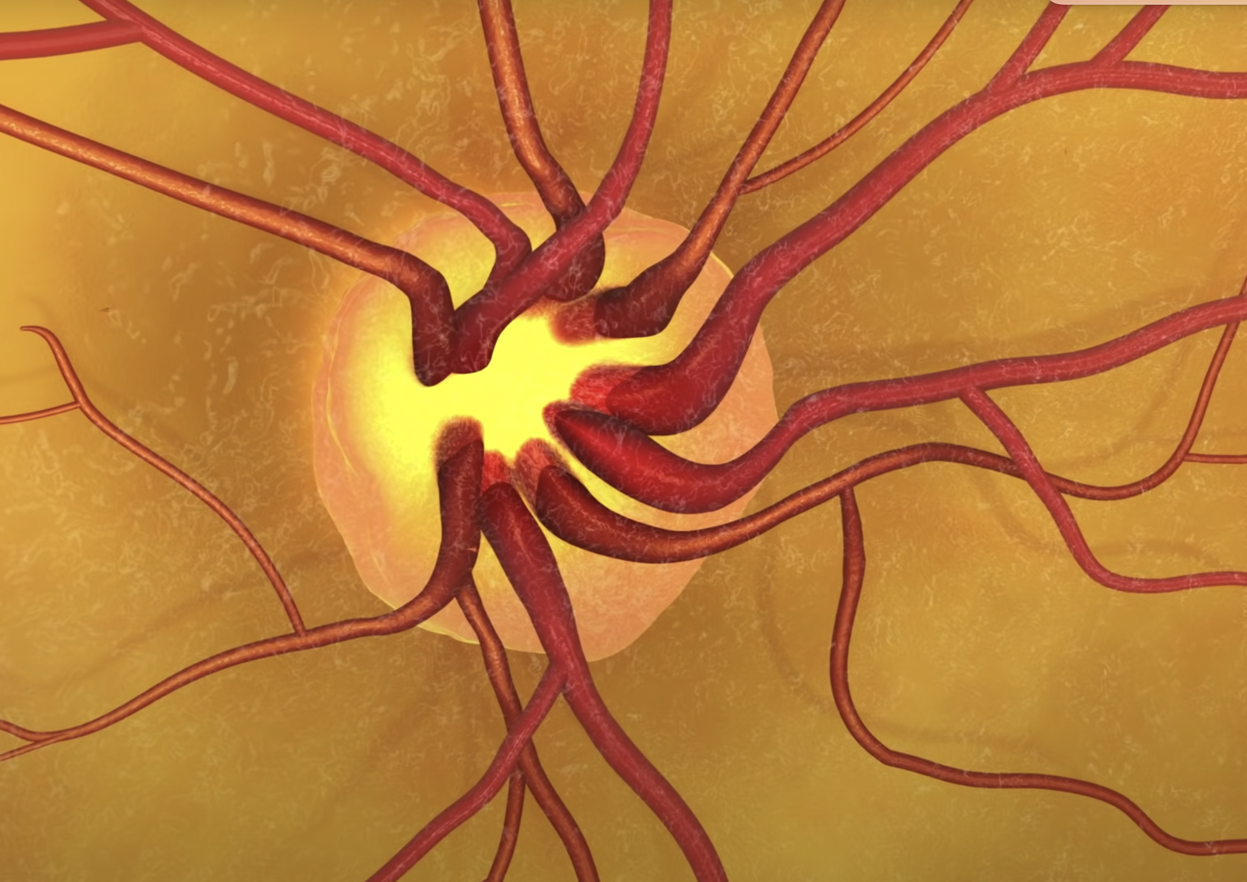
What does glaucoma look like during a dilated eye exam?
Optic nerve without glaucoma
Optic nerve with glaucoma
Want more information? Watch this video about how doctors look for glaucoma during a dilated eye exam: https://youtu.be/M6IlOKXlCqs

Slide 21



What are the treatments for glaucoma?
Medications — prescription eye drops are most common
Laser treatment — a simple procedure that’s usually painless
Surgery — your eye doctor can recommend the right type

Slide 22
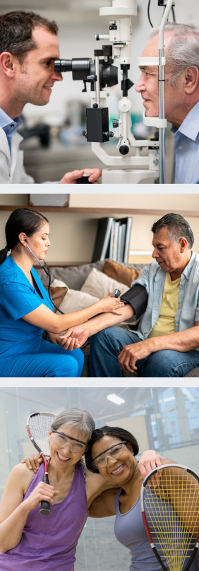
How can I help prevent glaucoma?
Visit your eye doctor for a comprehensive dilated eye exam every 1 to 2 years
Follow your doctor’s instructions for managing diabetes and high blood pressure
Wear protective eyewear for work, sports, and recreational activities

Slide 23
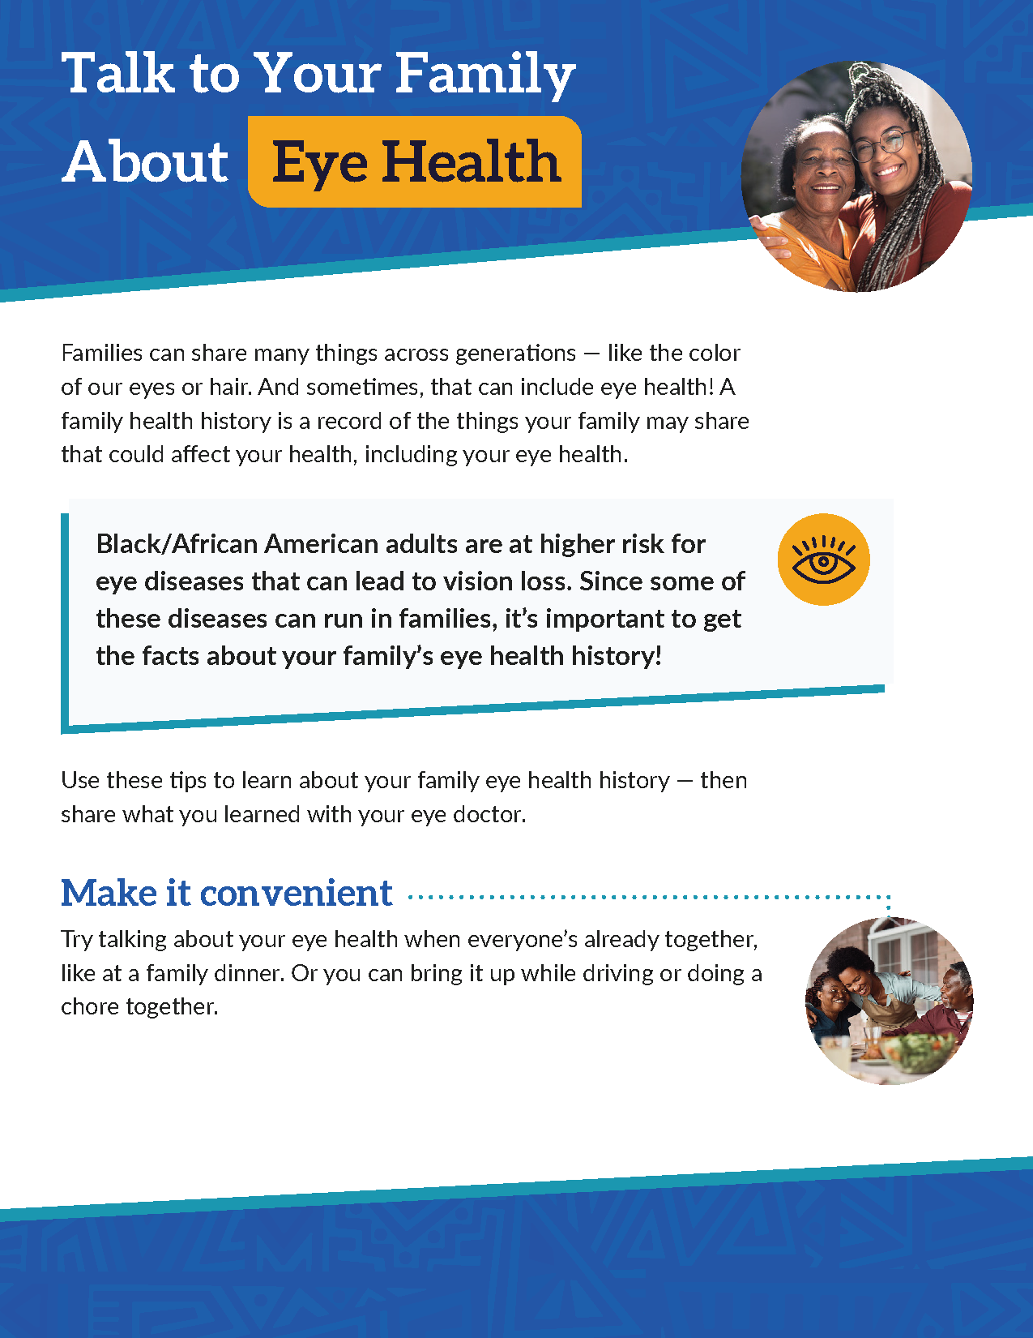
What are my next steps?
Find out if you have a family history of glaucoma. Get tips: nei.nih.gov/FamilyEyeHealthConvo
Schedule your next comprehensive dilated eye exam
Learn about the Medicare benefit that can help pay for part of an exam. Visit: nei.nih.gov/Medicare
Share what you learned with your family and friends

Slide 24
Wrap-up

Slide 25
Let’s review!
Glaucoma often has no symptoms
Glaucoma can cause permanent vision loss or blindness
Only an eye doctor can diagnose glaucoma
You can’t get back your vision after losing it to glaucoma — but early treatment can prevent this!

Slide 26
Questions?

Slide 27
More Information
Get more facts about glaucoma: nei.nih.gov/Glaucoma
Explore the See What I See virtual reality app: nei.nih.gov/VR
Learn about our eye health education program: nei.nih.gov/NEHEP

