Slide 1

Spotting the Signs:
User Guide
Resources to help educators identify and respond to potential vision concerns in Pre-K through Grade 2 students.

Slide 2
Keep an Eye Out
Educators are often the first to notice behaviors that may indicate a vision problem in their students. While you can’t diagnose a vision disorder, you can help identify those students who might benefit from a comprehensive eye exam.
Early recognition and timely communication with families
and school staff can help students receive the support
they need to succeed.

Slide 3
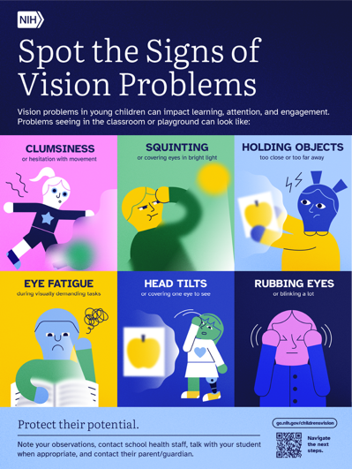
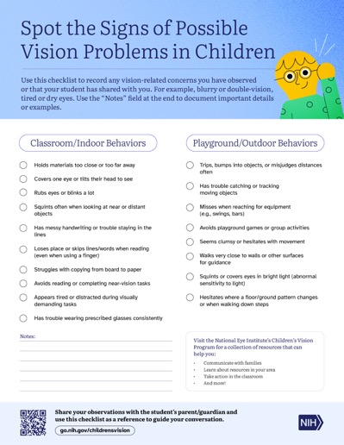
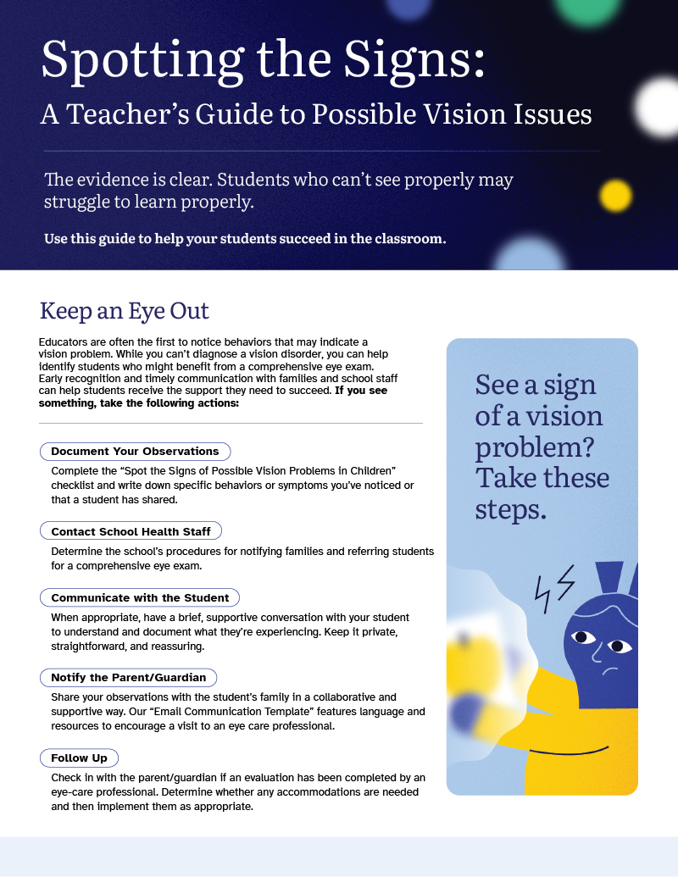
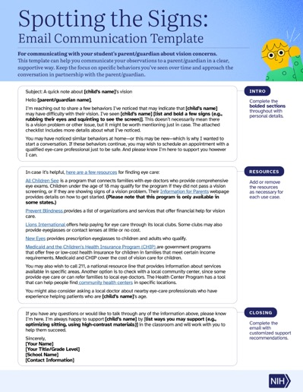
What are the Resources?
Poster with common signs of possible vision issues
Observation Checklist
Step-by-step informational fact sheet
Email communication templates

Slide 4
How Do I Use Them?
1
2
3
4
5
Review the
poster to learn signs of possible vision-related issues in your students.
Read the
fact sheet for
step-by-step guidance.
Document your observations using the checklist.
Connect with families using the communication template.
Apply classroom support strategies.

Slide 5
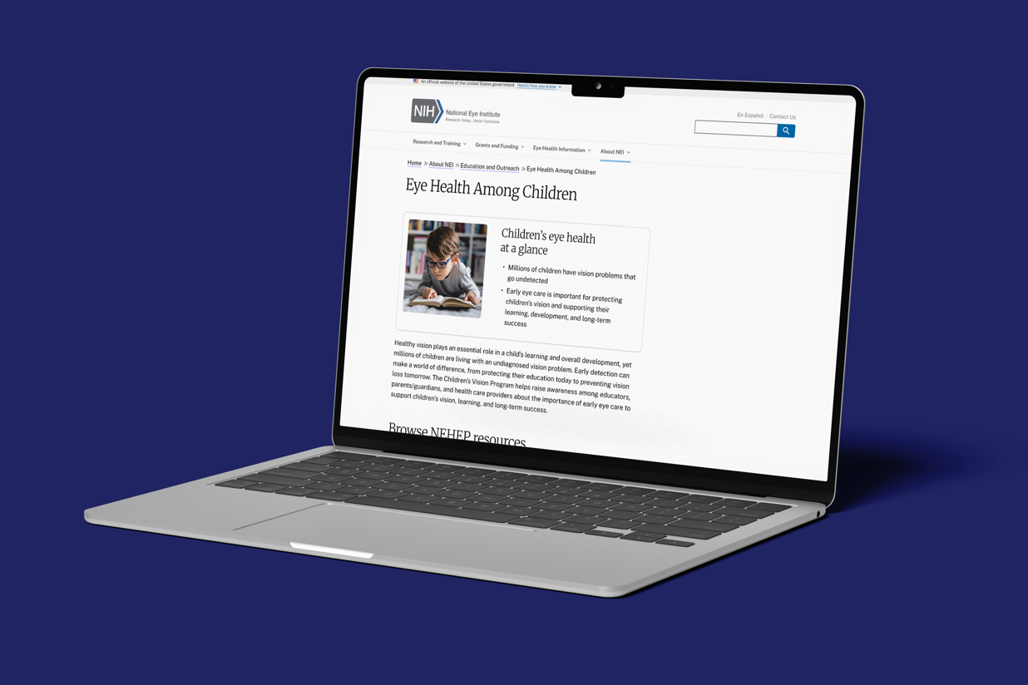
Where Can
I Get Them?
Download the resources at go.nih.gov/childrensvision
Call (800) 680-2578 or email 2020@nei.nih.gov to order printed copies.
Scan the
QR code to download.

Slide 6

Additional
Resources
Prevent Blindness - Signs of Possible Eye Problems in Children
Prevent Blindness - Children’s Screen Time – Tips and Resources
American Academy of Ophthalmology - Common Eye Problems in Children: Symptoms Every Parent Should Know
National Academies of Sciences, Engineering, and Medicine - Myopia: Causes, Prevention, and Treatment of an Increasingly Common Disease 2024 – Consensus Study Report

Slide 7
For More Information
School/District Contact: __________________
Title: __________________
Email: __________________
Phone: __________________
Website: __________________

Slide 8

Thank you

